Slide 1
INTERNSHIP STUDIO
PROJECT SUBMISSION
on
Ethical Hacking
DATE :- 22/08/2022

Slide 2
Task 1 : To solve any 5 labs in Portswigger Labs

Slide 3
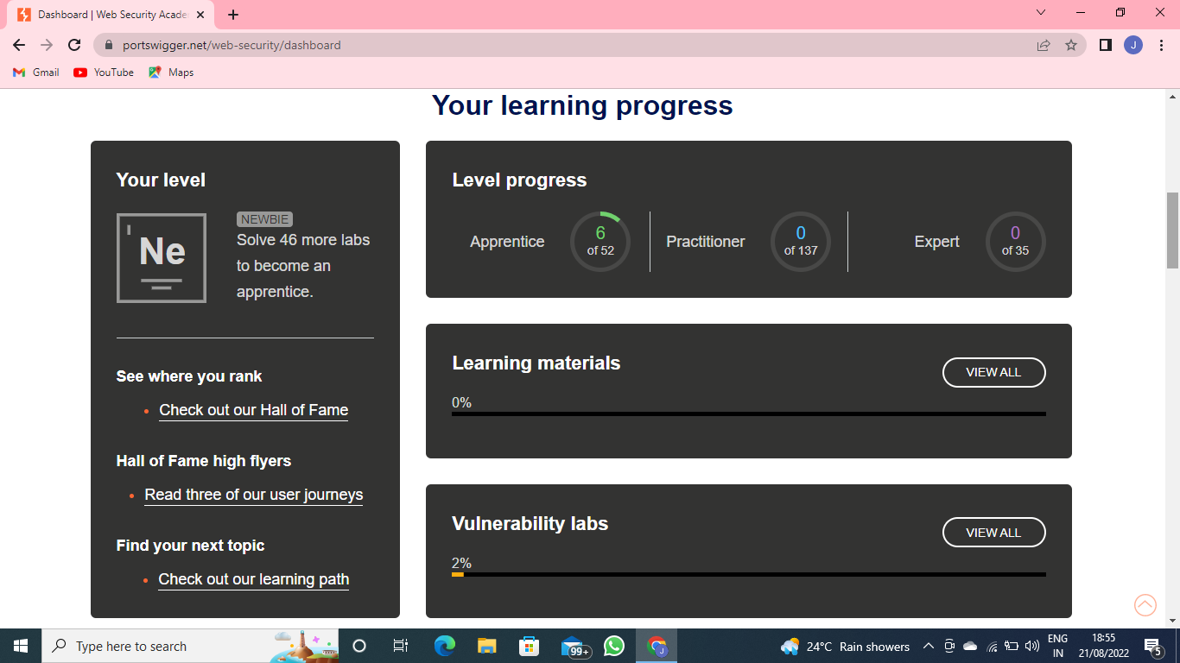
Screenshot 1

Slide 4
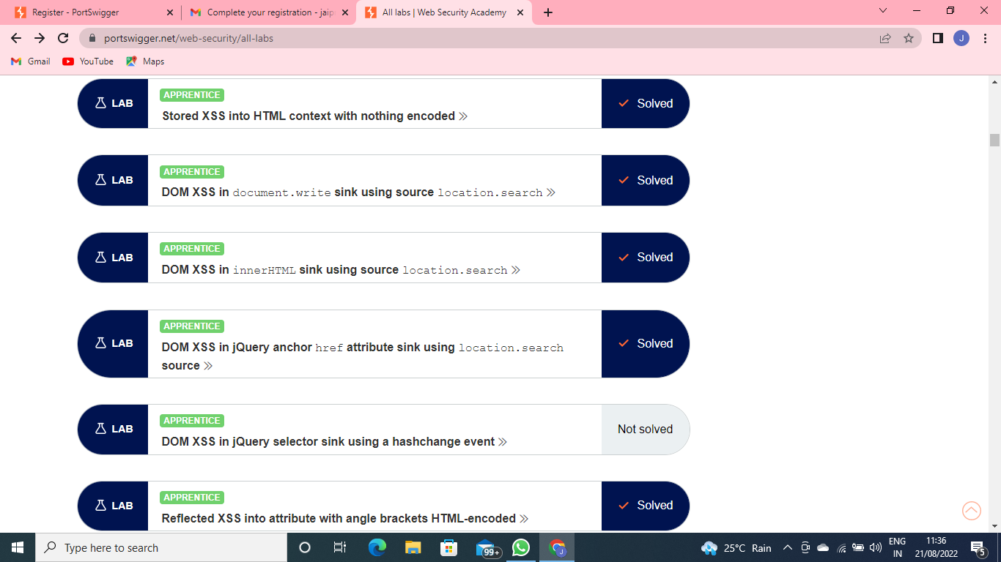
Screenshot 2

Slide 5
Task 2 : To find the vulnerabilities on the website http://zero.webappsecurity.com/ and to prepare a report for the same.

Slide 6
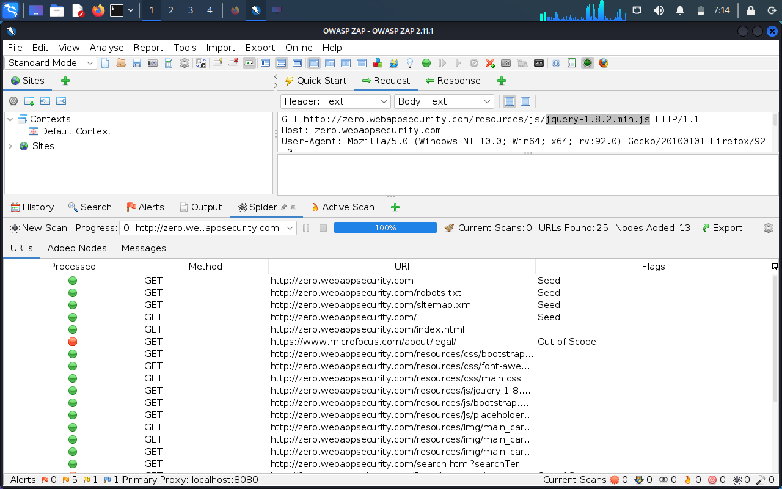
Screenshot of the vulnerabilities found by OWASP ZAP

Slide 7
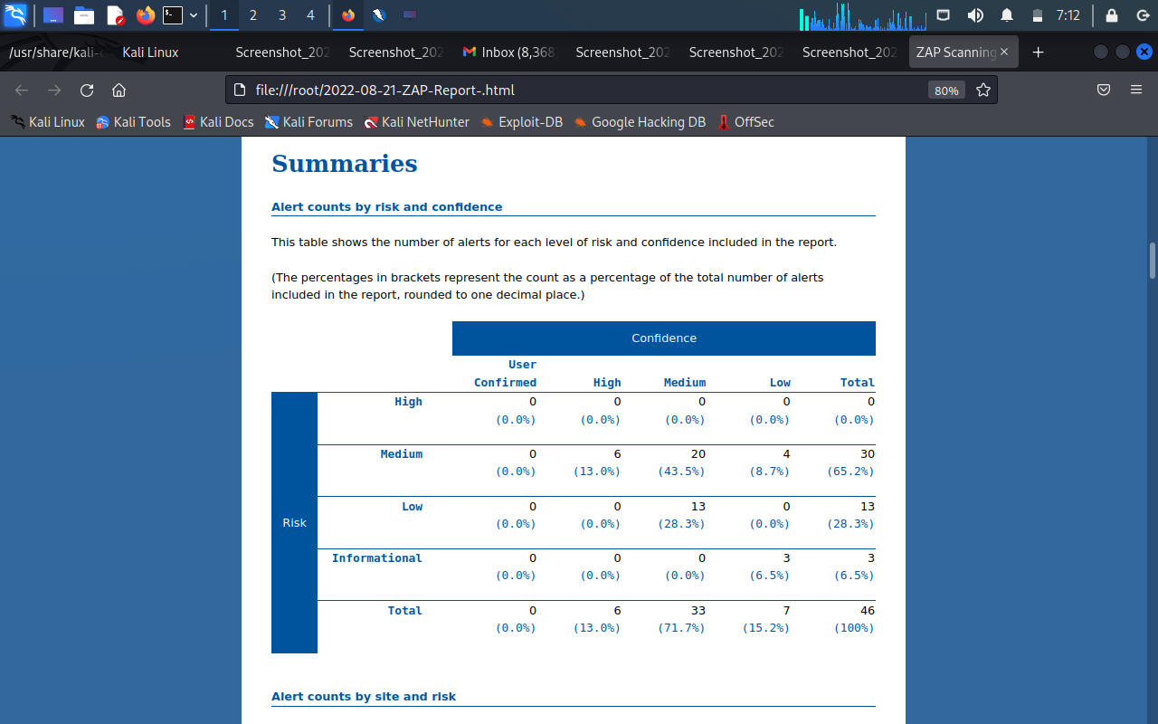
Screenshot 1 of report generated by OWASP ZAP

Slide 8
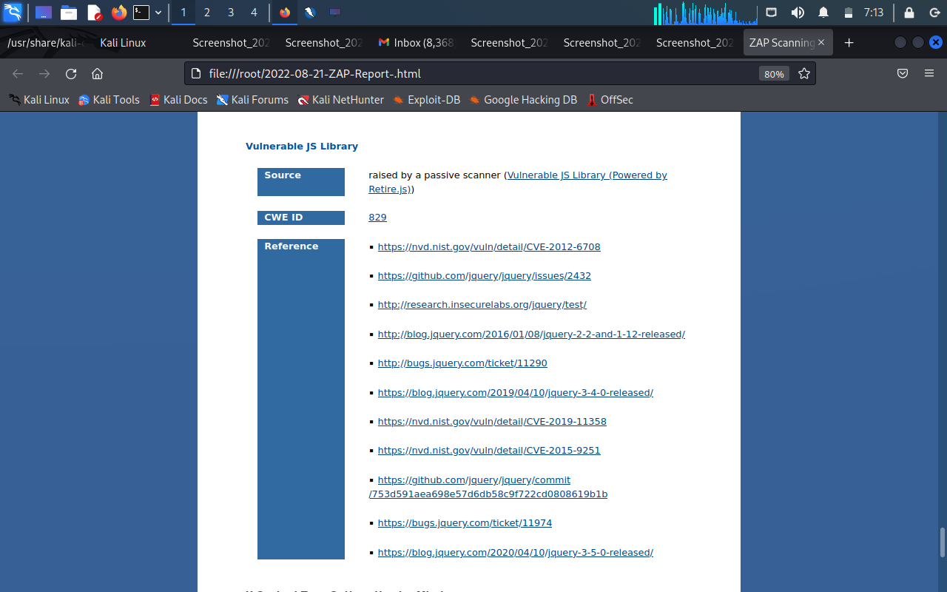
Screenshot 2 of report generated by OWASP ZAP

Slide 9
Report
Title : Vulnerable JS Library
Domain : http://zero.webappsecurity.com
Sub – domain : http://zero.webappsecurity.com/resources/js/jquery-1.8.2.min.js
Tools Used : Linux 7.1, OWASP ZAP, Wifi
Description : Vulnerability is found on the JS Library. The library jquery, version 1.8.2 is vulnerable.
Solution : The vulnerability found on the library jquery can be resolved by installing the latest version of jquery, version 3.6.0
Reference : https://nvd.nst.gov/vuln/detail/CVE-2012-6708
https://github.com/jquery/jquery/issues/2432
http://research.insecurelabs.org/jquery/test

Slide 10
Task 3 : To find the vulnerabilities on the website http://testasp.vulnweb.com/

Slide 11
Report :
Title :
Cross Site Scripting
Domain : http://vulnweb.com/
Sub – domain : http://testasp.vulnweb.com/Search.asp
Tools Used : Linux 7.1, Wifi
Description :
The website of http://testasp.vulnweb.com/ has a Cross Site Scripting vulnerability whose risk parameter is very high and the attacker can easily access the vital information of the clients. As per OWASP’s definition “ Cross Site Scripting (XSS) is an attack technique that involves echoing attacker-supplied code into a user’s browser instance. When an attacker gets a user’s browser to execute his/her code, the code will run within the security context (or zone) of the hosting website. With this level of privilege, the code has the ability to read, modify and transmit any sensitive data accessible by the browser”.

Slide 12
Steps to Reproduce :
Step 1 : Visited http://testasp.vulnweb.com/
Step 2 : On the top left side of the menu there is a Search option.
Step 3 : Clicked on the Search option and typed a parameter (for ex. Marvel) and clicked on Search button.
Step 4 : Now, in place of the parameter, typed the XSS payload : <script>alert(1)</script>.
Step 5 : After clicking on the Search button an alert popped up on the screen.

Slide 13
Impact :
Code injected into a vulnerable application can remove data or install malware on the user’s machine.
An attacker can deface a corporate website by altering its content, thereby damaging the company’s image or spreading misinformation.
Attackers often steal session cookies and in the browser to hijack legitimate user accounts.
Attackers can also make a clone of the login page of the web application and then use Cross Site Scripting vulnerabilities to serve it to the users.
PoC :
For the Proof of Concept, the documents are attached with the report.

Slide 14
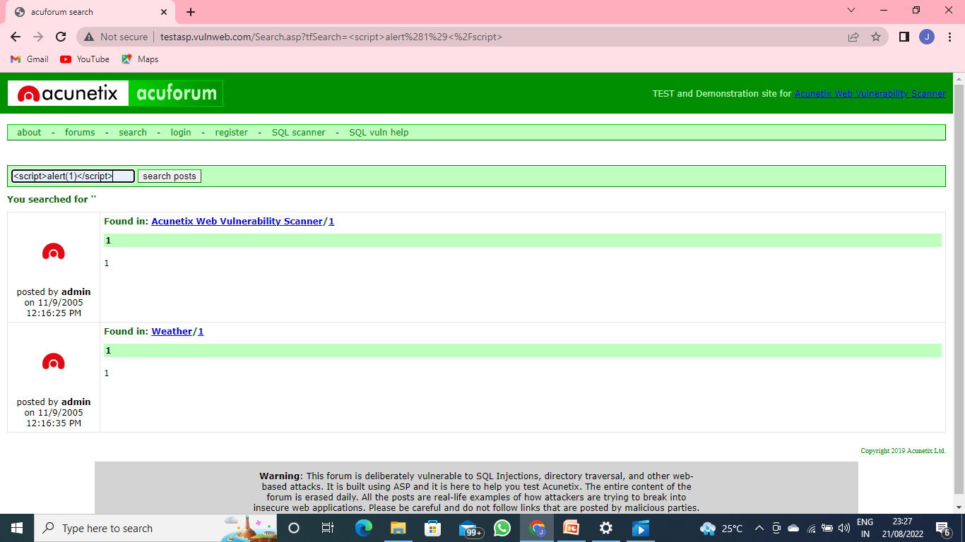
Screenshot 1

Slide 15
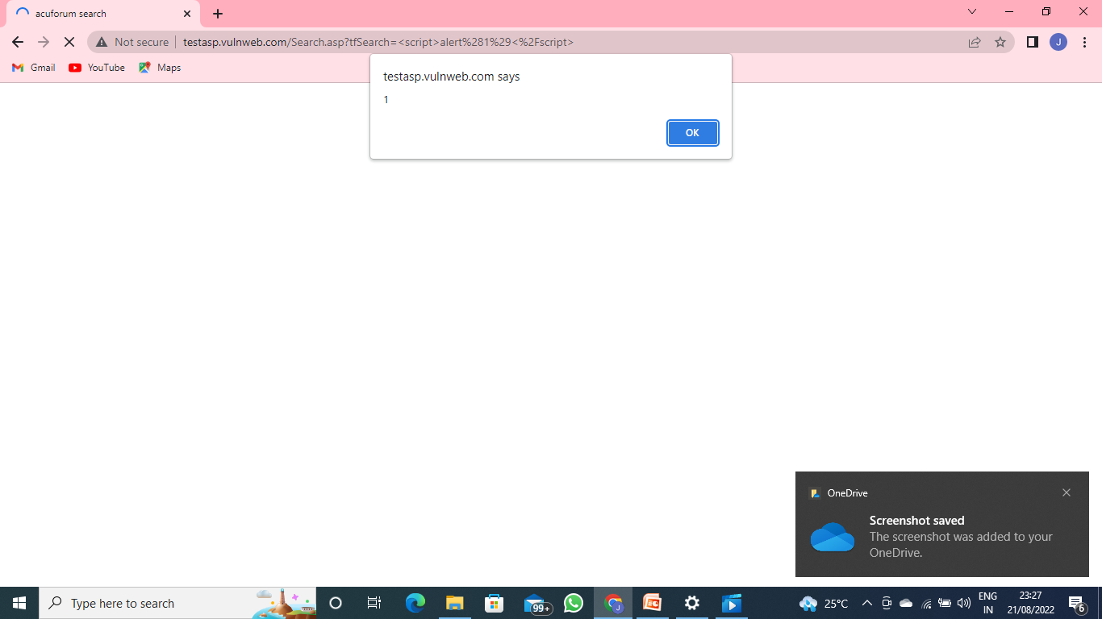
Screenshot 2

Slide 16

Video of the found vulnerability

Slide 17
Thank You

